Slide 1




Brief Introduction
PROBLEM STATEMENT
Lack of awareness of generic medicines and government schemes among the people in rural areas.
Solution:
We have developed an end to end website, where the user can inquire about the generic medicine, and comparison of generic with non-generic medicines and opting for best generic alternative and user can just fill out his/her basic details and our website will suggest the best government schemes available to them offering health benefits at negligible cost.
Team- FROZA
Amit Singh
Ankit Jangra
Pranay Anand
Snehal Srivastava

Slide 2






Tech Stacks used
HTML
JAVASCRIPT
MySQL
CSS
Python
FLASK

Slide 3
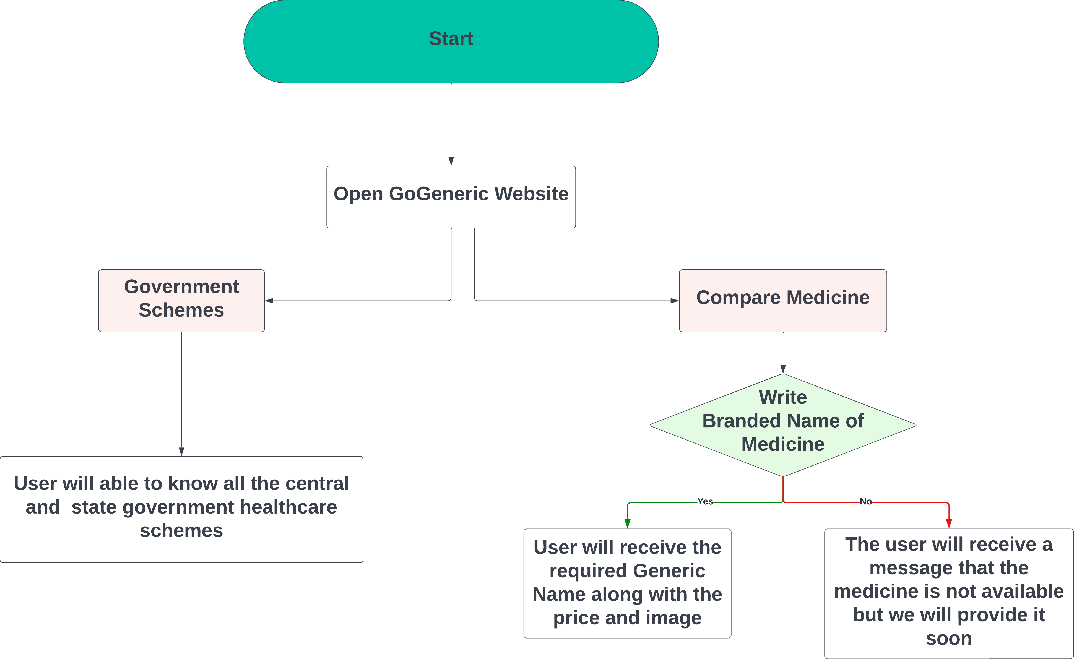
FLOWCHART OF WORKING OF CHART

Slide 4


UNIQUE SELLING POINT
Community-Centric Approach
USP: Focused on building a strong sense of community.
How: Emphasize features that encourage users to connect, share, and collaborate on social initiatives. Create forums, groups, or events where users can actively engage.
Trust and Quality Assurance:
USP: Ensuring the authenticity and quality of generic medicines.
How: Implement quality assurance measures, provide detailed product information, and perhaps collaborate with reputable generic pharmaceutical manufacturers

Slide 5



HOW WILL WE MARKET?
With a dedicated team of compassionate women already on board, our social healthcare app is poised for success in rural areas. The “Local Mahila Mandal “ will help us to market and spread awareness in the locality.
We are committed to fostering community awareness through strategic collaborations with college societies, such as NSS. By engaging in regular awareness programs, we aim to promote and solidify the concept, ensuring widespread understanding and support for our impactful initiatives.
In a strategic partnership with an NGO, we aim to leverage their expertise to compile comprehensive medicine data while also benefiting from their marketing support. This collaboration will not only enhance our database but also amplify our outreach, ensuring our healthcare app reaches and serves a wider audience effectively.

Slide 6




SWOT ANALYSIS
SWOT(Strength, Weakness, Opportunities, Threat). It help us to find the future growth of the project
First Mover Advantage: No Platform has done it yet since we will create a new market
Create extensive database and entry of new competitors in market on a regular basis
WEAKNESS
STRENGTH
Pharma Consultant Support by Industry Specialist Available at Volunteer basis
THREATS
OPPORTUNITIES
As Government is Promoting Generic Medicine. We have a good opportunity to tie up with the government
Data breach can lead to huge cost as our data is the key and so it can be replicated easily
We have a great opportunity to target the lower middle class as it is majority in population

Slide 7

THANKYOU

